Slide 1

Mood Picture
Project I – Masters in Creative Computing and AI
Author: Alan Caetano.

Slide 2
Goals
The main goal of this project is to make people reflect about their mood.

Slide 3
GOALS
This project also aims to raise awareness about the importance of mental health checkups and lifestyle changes to prevent extreme psychological problems.

Slide 4
Goals
The first use case to be explored is going to be environments that people stay for extended periods of time. For example, their home and work environments.
People tend to not be aware of the stress level raise on the environment they are in, so it’ll be interesting to make people reflect about a visual representation of the sounds patterns.

Slide 5
Main Functionalities
Gather data that could represent the user’s mood;
Creation of a visual representation of the input data, using generative art techniques; (This should translate this data into an meaningful output for the user reflection)

Slide 6
Main Functionalities
Build an intelligent agent to determine the probability of an stressful pattern based on sound intermittency and maximum amplitude as others, using this output as another dimension on the creative output;
Use gamification techniques to combine data from multiple environments and to define collaborative goals.

Slide 7
PRODUCT use case
User turn off the sensor.
User inform their mood perception on a form.
The animation is generated and shown.
User turn on the sensor.

Slide 8
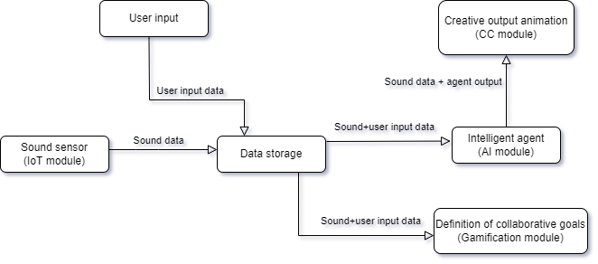
System structure

Slide 9
System structure - iOt module
A sound sensor will get the sound amplitude readings from the environment.
The amplitude readings will be grouped by a time period (few minutes) in the form of average and max amplitude.
This data will be sent each time period to be stored on a server by HTTP requests.
Will be used an Arduino board to read the data from the sensor, apply the grouping logic and make the request to the server.

Slide 10
System structure - AI module
Will be created an intelligent agent to decide if the sound sensor reading is going to be considered an stressful or not stressful situation by the creative module.
The JS library tau-prolog (available in http://tau-prolog.org/) will be used to build the agent in order to better integrate with the creative module.

Slide 11
System structure - AI module
The inputs for the agent will be:
Sound readings grouped by time period;
Input made by the users about their perception.
The agent will compare maximum amplitudes with the averages and determine the level of sound intermittency. This intermittency level, calibrated by the user perception, will define the periods with more stress.

Slide 12
System structure – CC Module
influenced
Use of generative art techniques to create an output based on the input data that represents the user’s environment mood on that period of time.
The animation will be an stylized particle system influenced by 2 dimensions:
The maximum amplitudes will define the agitation of the particles;
The stress level returned by the intelligent agent will “heat” the color gradient.

Slide 13
System structure – CC Module
influenced
The p5.js (available in https://p5js.org/) was chosen to implement the creative output animation because the user interaction with the system will be through a web application.

Slide 14
System structure – Gamification Module
The gamification module will be implemented with forms on the web application to input the goals and pages to display the completed goals, streaks and users comparation.

Slide 15
conclusions
As the world discuss a global epidemic of mental illness, campaigns or experiments to raise awareness about mental health care become important tools to make people reflect about their mental state and seek for help.
In this cases, awareness and prevention could play a main role on avoiding extreme mental health problems and affecting others on the same environment before seeking for professional help and changing lifestyle.

Slide 16
Future work
A next step on this project could be using complementing the input data with another sensors (like heart rate monitors, for example) and data from health APIs(like Apple Health).
Adding to that, a more deep research could be done on how to measure stress to add more complex and realistic rules to the intelligent agent.

